Slide 1
Topics will Be Covered:
Average or Mean Value of Waveforms
RMS or Effective Value of Waveforms
Average Value and RMS Value for Rectangular Waveform
Phasor Algebra/Complex Number
APPLICATION OF COMPLEX NUMBERS IN AC CIRCUIT
Impedance: Resistance and Reactance
Admittance: Conductance and Susceptance

Slide 2
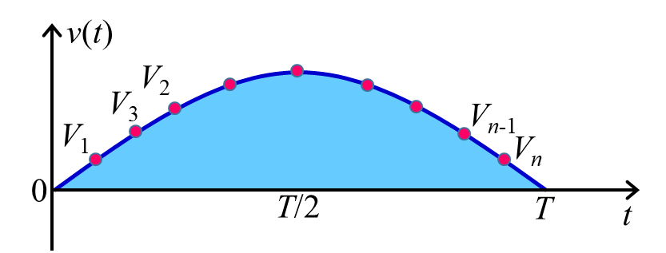
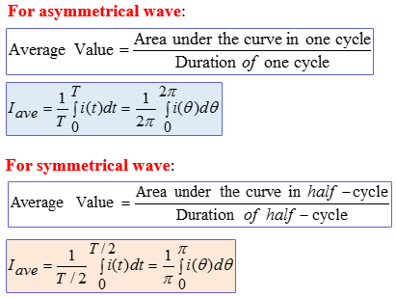
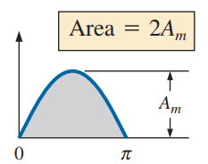
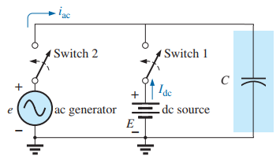
Average Value or Mean Value
Average Value: The average value of an alternating current is expressed by that dc current which transfers across any circuit the same charge as is transferred by that alternating current during the same time.
Graphical Method:
In case of symmetrical waveform, the average value over a full cycle is zero. Thus, the average value is calculated over half-cycle for symmetrical waveform. But for asymmetrical waveform, the average value is calculated over a full cycle.
Analytical or Integral Method:
Average value can be calculated by the following methods:
Graphical Method
Analytical or
Integral Method
2

Slide 3
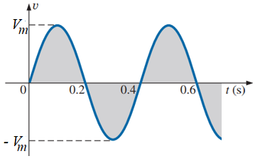
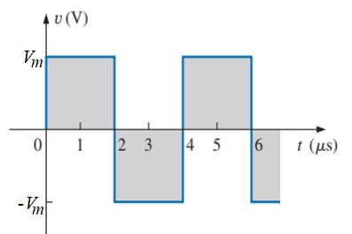
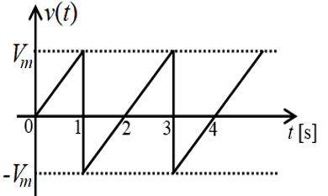
Sine Waveform
Symmetrical Triangular Waveform
Square Waveform
Symmetrical Sawtooth Waveform
3

Slide 4
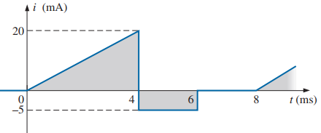
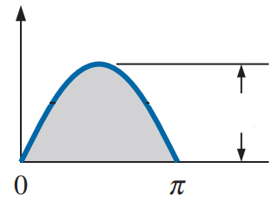
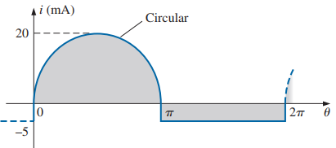
EXAMPLE 13.14.1 Determine the average value for the following waveforms.
We know that the area of half-cycle of sine wave = 2 × Peak Value
i(t) [A]
20
4

Slide 5
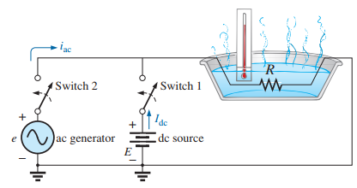

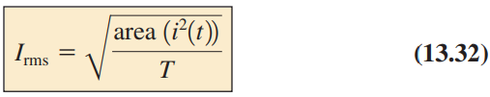
Root Mean Square (RMS) or Effective Value
RMS or Effective Value: The effective or RMS value of an alternating current is given by that dc current which, when flowing through a given circuit for a given time, produces the same amount of heat as produced by the alternating current, when flowing through the same circuit for the same time.
RMS value can be calculated by the following methods:
Graphical Method
Analytical or Integral Method
Graphical Method:
Analytical or Integral Method:
5

Slide 6
Sine Waveform
Symmetrical Triangular Waveform
Square Waveform
Symmetrical Sawtooth Waveform
6

Slide 7
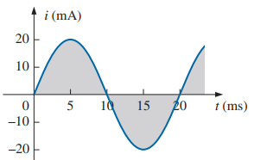
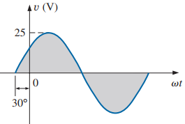
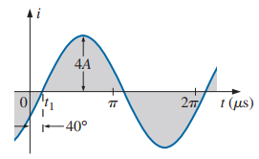
EXAMPLE 13.20 Find the average value and rms values for the following sinusoidal waveforms.
(a)
(b)
(c)
Here, I_{m} = 20 mA
Here, V_{m} = 25 V
Here, I_{m} = 4 A
7

Slide 8
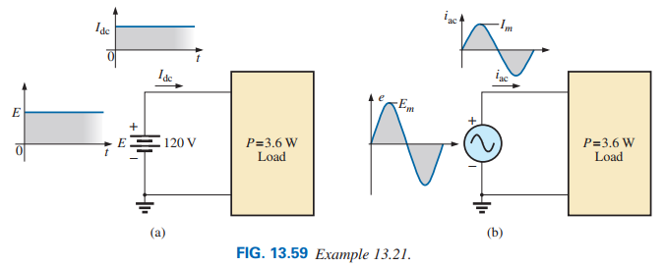
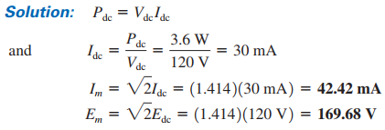
EXAMPLE 13.21 The 120 V dc source in Fig. 13.59(a) delivers 3.6 W to the load. Determine the peak value of the applied voltage (E_{m}) and the current (I_{m}) if the ac source [Fig. 13.59(b)] is to deliver the same power to the load.
EXAMPLE 13.20.1 Find the average value and rms values for the following sinusoidal waveforms:
(a) i(t) = 10sin(ωt + 30°) A
(b) v(t) = 150cos(ωt − 60°) A
(c) i(t) = − 12cos(ωt + 80°) μA
(d) v(t) = − 200sin(ωt − 120°) mV
8

Slide 9
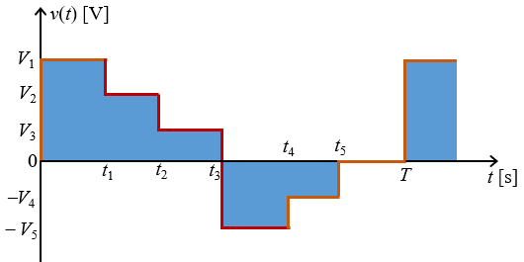
Average Value and RMS Value for Rectangular Waveform
A₁
A₂
A₃
A₆
A₅
A₄
9

Slide 10
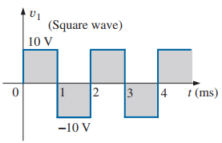
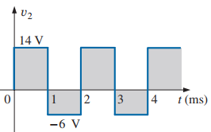
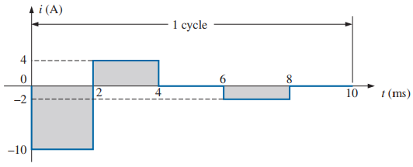
EXAMPLE 13.14 Determine the average value, the rms value for the following waveforms.
(a)
(b)
(c)
(a)
(c)
(b)
10

Slide 11
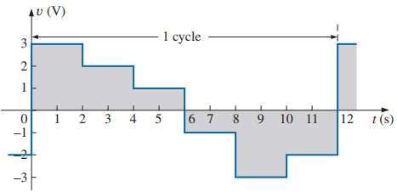
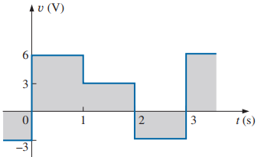
EXAMPLE 13.14.1 Determine the average value, the rms value for the following waveforms. Also, determine the average power consumption if the voltage applied across 10 ohm resistance.
Practice Problems 37 ~ 46 [Ch. 13]
11

Slide 12
Chapter 14
The Basic Elements and Phasors
Phasor Algebra/Complex Number

Slide 13

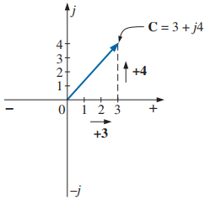
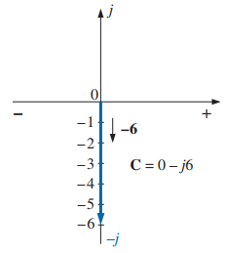
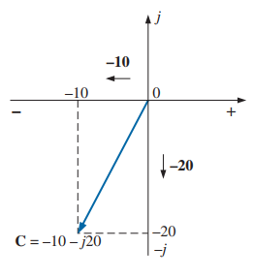
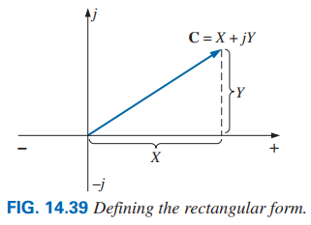
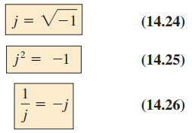

Vector Quantities Represent by Complex Number :
1. Magnitude 2. Direction
Phasor Quantities Represent by Complex Number:
1. Magnitude (RMS value for voltage and current)
2. Direction (Phase angle)
3. Continuously change with respect to time [such as sine and cosine waves)
Complex Number can be represented by three different ways:
1. Polar or Phasor form
2. Cartesian or Rectangular form
3. Exponential form
14.7 RECTANGULAR FORM:
$$C=X+jY (14.17)$$
13

Slide 14

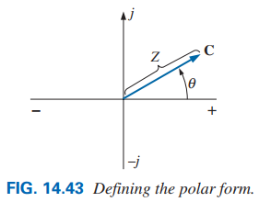
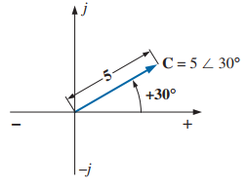
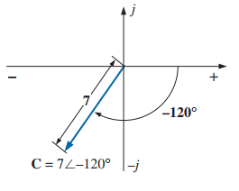
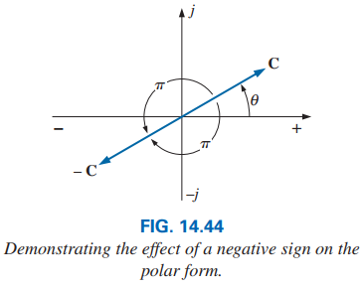
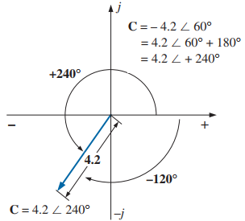


14.8 POLAR OR PHASOR FORM:
$$C=Zθ (14.18)$$
$$C=−Zθ=−Zθ±180° (14.19)$$
14

Slide 15
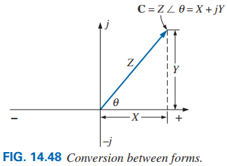
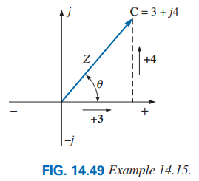
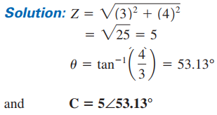
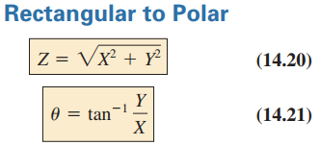

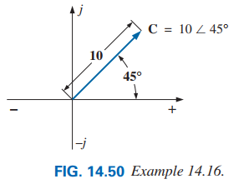
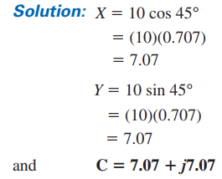
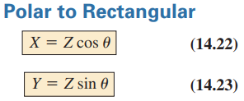
14.9 CONVERSION BETWEEN FORMS
15

Slide 16
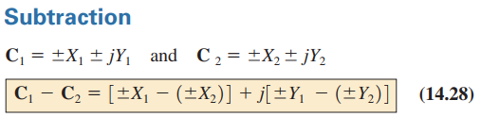
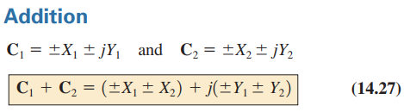
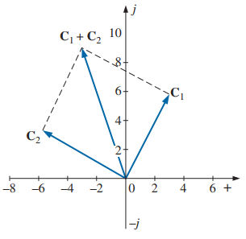
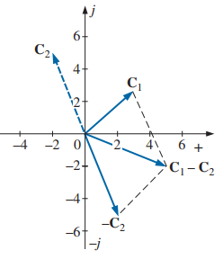
14.10 MATHEMATICAL OPERATIONS WITH COMPLEX NUMBERS
16

Slide 17
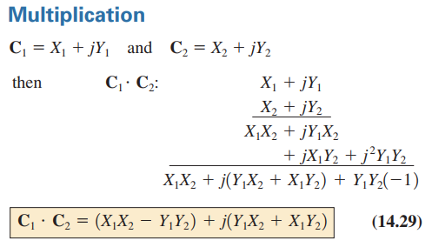
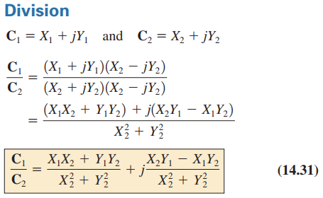
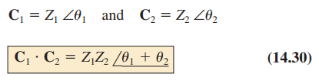
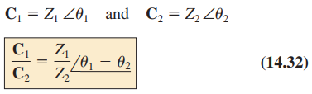
Multiplication in Polar Form:
Division in Polar Form:
17

Slide 18
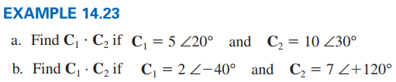
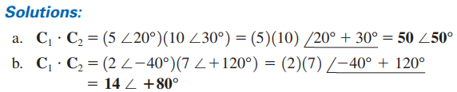


Practice Problem 39 ~ 49 [Ch. 14]
18

Slide 19







APPLICATION OF COMPLEX NUMBERS IN AC CIRCUIT
Instantaneous Form (Time Domain) Equation:
Phasor Form (Polar Form) Equation:
Rectangular Form (Cartesian Form) Equation:
$$e\left(t\right)=E_{m}sin\left(ωt+θe\right) V$$
$$v\left(t\right)=V_{m}sin\left(ωt+θv\right) V$$
$$i\left(t\right)=I_{m}sin\left(ωt+θi\right) A$$
$$E=\vec{E}= E_{rms}∠θe= E∠θe V$$
$$V=\vec{V}=V_{rms}∠θv=V∠θv V$$
$$I=\vec{I}=I_{rms}∠θi=I∠θi A$$
$$E=\vec{E}=E_{r}+jEi V$$
$$V=\vec{V}=V_{r}+jVi V$$
$$I=\vec{I}=I_{r}+jIi A$$
EXAMPLE 14.27 Convert the following from the time to (i) the phasor domain, and (ii) the rectangular domain.
Time Domain
Phasor Domain
Rectangular Domain
(a) v(t) = 70.7sin(ωt − 60º) V
$$\vec{V}=\left(0.707×70.7\right)V∠\text{−}\text{60}\text{o}=50V∠\text{−}\text{60}\text{o}$$
$$V=25 \text{−} j43.3 V$$
(b) i(t) = 21.21cos(ωt + 20º) A
$I=$ 15[cos($\text{11}\text{0}\text{o}$)+j sin($\text{11}\text{0}\text{o}$)]
$$=\text{−}5.13 \text{+ }j14.1 A$$
= 21.21sin(ωt + 110º) A
$$\vec{I}=\left(0.707×21.21\right)A∠\text{11}\text{0}\text{o}=15A∠\text{11}\text{0}\text{o}$$
(c) e(t) = − 200cosωt V
$E=$141.42[cos($\text{}\text{90}\text{o}$)+j sin($\text{}\text{90}\text{o}$)]
$$=0 \text{− }j141.42 V$$
$$\vec{E}=\left(0.707×200\right)V∠\text{−}\text{9}\text{0}\text{o}=141.42V∠\text{−}\text{9}\text{0}\text{o}$$
= 200sin(ωt − 90º) V
(d) i(t) = −4.5sin (ωt + 30º) A
$$\vec{I}=\left(0.707×4.5\right)A∠\text{−}\text{15}\text{0}\text{o}=3.18A∠\text{−}\text{15}\text{0}\text{o}$$
$I=$3.18[cos($\text{21}\text{0}\text{o}$)+j sin($\text{21}\text{0}\text{o}$)]
$$\text{ = }\text{−}2.75 \text{−} j1.59 A$$
= 4.5sin (ωt − 150º) A
= 4.5sin (ωt + 210º) A
$$\vec{I}=\left(0.707×4.5\right)A∠\text{2}\text{1}\text{0}\text{o}=3.18A∠\text{21}\text{0}\text{o}$$

Slide 20















EXAMPLE 14.27.1 Convert the following from Cartesian form to (i) the phasor domain, and (ii) the instantaneous form for 50 Hz.
Rectangular Form
Phasor Form
Instantaneous Form
(a) $\vec{V}=25 \text{−} j43.3 V$
$$V= \sqrt{{25}^{2}+{(−43.3)}^{2}}=50 V$$
$θ_{v}$=$\tan^{−1}\left[\frac{−43.3}{25}\right]=\text{−}\text{60}\text{o}$
$$V=50V∠\text{−}\text{60}\text{o}$$
ω =2π×50 = 314 rad/s
RMS value: 50 V
Phase Angle: $\text{}\text{60}\text{o}$
Peak Value: 70.7 V
v(t) = ($\sqrt{2}$)×50sin(314t − 60º) V
= 70.7sin(314t − 60º) V
(b) $\vec{E}= j150 V$
$$E= \sqrt{0^{2}+{150}^{2}}=150 V$$
$θ_{e}$=$\tan^{−1}\left[\frac{150}{0}\right]=\text{9}\text{0}\text{o}$
$$E=150V∠\text{9}\text{0}\text{o}$$
e(t) = ($\sqrt{2}$)×150sin(314t + 90º) V
= 212.13sin(314t + 90º) V
= 212.13cos314t V
RMS value: 150 V
Phase Angle: $\text{9}\text{0}\text{o}$
Peak Value: 212.13 V
(d) $\vec{I}= \text{−} j5 A$
$$I= \sqrt{0^{2}+{(−5)}^{2}}=5 A$$
$θ_{i}$=$\tan^{−1}\left[\frac{−5}{0}\right]=\text{−}\text{9}\text{0}\text{o}$
$$I=5A∠\text{−}\text{9}\text{0}\text{o}$$
i(t) = ($\sqrt{2}$)×5sin(314t $−$ 90º) A
= 7.07sin(314t $−$ 90º) A
= $−$7.07cos314t A
RMS value: 5 A
Phase Angle: $−\text{9}\text{0}\text{o}$
Peak Value: 7.07 A
(e) $\vec{V}= \text{−} 100 V$
v(t) = ($\sqrt{2}$)×100sin(314t ± 180º) V
= 141.42sin(314t ± 180º) V
= $−$141.42sin314t V
$$V=100V∠±\text{18}\text{0}\text{o}$$
RMS value: 100 V Phase Angle: ± 180º Peak Value: 141.42 V

Slide 21



Impedance
Practically, − 90º≤θ_{z}≤ 90º
Reactance is the property of inductor and capacitor to oppose the flow of current. The are two reactance in electrical circuit: (i) inductive reactance (X_{L}), and (ii) capacitive reactance (X_{C}).
Impedance: Impedance is the ratio of voltage to current.
Impedance opposes the flow of current.
Impedance represent by Z. Its unit is ohm (Ω).
$$Z=\frac{V}{I}=\frac{V_{rms}θ_{v}}{I_{rms}θ_{i}}=\frac{Vθ_{v}}{Iθ_{i}}=\frac{V}{I}\left(θ_{v}−θ_{i}\right)=Zθ_{z}=R+jX $$
Magnitude of Impedance: $Z=\frac{V_{m}}{I_{m}}=\frac{V_{rms}}{I_{rms}}=\frac{V}{I} $
Angle of Impedance:$θ_{z}=θ_{v}−θ_{i}$
Impedance (Z) is not a phasor quantity because for a circuit it is constant. That means impedance does not change with respect to time.
Resistance (Real Part of Impedance): $R=Zcosθ_{z} $
Reactance (Imaginary Part of Impedance): $X=Zsinθ_{z} $
21

Slide 22




Admittance
Conductance (Real Part of admittance):
$G=\frac{1}{R}=Ycosθ_{y} S$
Susceptance (Imaginary Part of admittance):
$B=\frac{1}{X}=Ysinθ_{y} S$
Admittance (Y) is also not a phasor quantity.
Admittance: Admittance is the ratio of current to voltage. Admittance is reciprocal of impedance.
Admittance is a measure of how well an ac circuit will admit, or allow, current to flow in the circuit.
Admittance represent by Y. Its unit is Siemens (S).
Susceptance is the property of inductor and capacitor to help the flow of current. The are two susceptance in electrical circuit: (i) inductive susceptance (B_{L}), and (ii) capacitive susceptance (B_{C}).
$$Y=\frac{1}{Z}=\frac{I}{V}=\frac{I_{rms}θ_{i}}{V_{rms}θ_{v}}=\frac{Iθ_{i}}{Vθ_{v}}=\frac{I}{V}\left(θ_{i}−θ_{v}\right)$$
$=Yθ_{y}=G+jB$S
Magnitude of Admittance: $Y=\frac{1}{Z}=\frac{I_{m}}{V_{m}}=\frac{I_{rms}}{V_{rms}}=\frac{I}{V} S$
Angle of Admittance:$θ_{y}={−θ}_{z}= θ_{i}−θ_{v}$
22

Slide 23
EXAMPLE The supply voltage and current of a circuit are v(t) = 100sin314t V and i(t) = 15cos(314t−120º) A.
(a) Find (i) the magnitude of impedance, (ii) the angle of impedance, (iii) the value of resistance, and (iv) the value of reactance.
(b) Find (i) the magnitude of admittance, (ii) the angle of admittance, (iii) the value of conductance, and (iv) the value of susceptance.
(c) Write the impedance and admittance in both polar and cartesian or rectangular form.
Solution: Converting current from cosine to sine, we have: i(t) = 15sin(314t−30º) A.
Now, V_{m} = 100 V, I_{m} = 15 A, θ_{v} = 0º and θ_{i} = −30º
23

Slide 24
EXAMPLE The supply voltage and current of a circuit are V = 200V∠90º and I = 10A∠30º.
(a) Find the impedance and admittance in both polar and cartesian or rectangular form.
(b) Find (i) the magnitude of impedance, (ii) the angle of impedance, (iii) the value of resistance, and (iv) the value of reactance.
(c) Find (i) the magnitude of admittance, (ii) the angle of admittance, (iii) the value of conductance, and (iv) the value of susceptance.
Solution:
24

Slide 25
EXAMPLE The supply voltage and impedance of a circuit are v(t) = 282.84cos314t V and Z = 20Ω∠60º.
Find the current i(t).
EXAMPLE The supply current and impedance of a circuit are i(t) = 15sin377t V and Z = 17.32 + j10 Ω.
Find the voltage v(t).
Solution: Converting voltage from cosine to sine, we have: v(t) = 282.84sin(314t+90º) V.
Solution: Converting impedance from Cartesian to Polar form:
Now, V_{m} = 282.84 V, θ_{v} = 90º and Z = 20 Ω, θ_{z} = 60º
Now, I_{m} = 15 V, θ_{i} = 0º and Z = 20 Ω, θ_{z} = 30º
We know that:
We know that:
Thus,
i(t) = 14.142sin(314t + 30º) A
Thus,
v(t) = 300sin(377t + 30º) V
25

Slide 26


Voltage Source Given in Different Ways
Current Source Given in Different Ways
26

Slide 27
Impedance Diagram
j (1∠ 90º)
Imaginary-Axis
B
C
Z
X = 40 Ω
Z
Z = 50 Ω
Z = 50 Ω
X = 40 Ω
53.13º
O
R = 30 Ω
A
j² = − 1 (1∠ ±180º)
Real-Axis (1∠0º)
53.13º
R = 30 Ω
− j (1∠ 270º =1∠− 0º)
Moving Method
Parallelogram Method
27

